Slide 1

Basic Introduction to Generative AI
2023/11/03
IT ETD / Jimmy Hsu

Slide 2

Contents
What is Gen AI ?
What is AI ?
ML v.s Deep Learning
Gen AI
Types of Gen AI
Text
Image
Video
Gen AI Tools in Micron
Now
Future
What is the impact of Gen AI

Slide 3
What is Gen AI ?

Slide 4
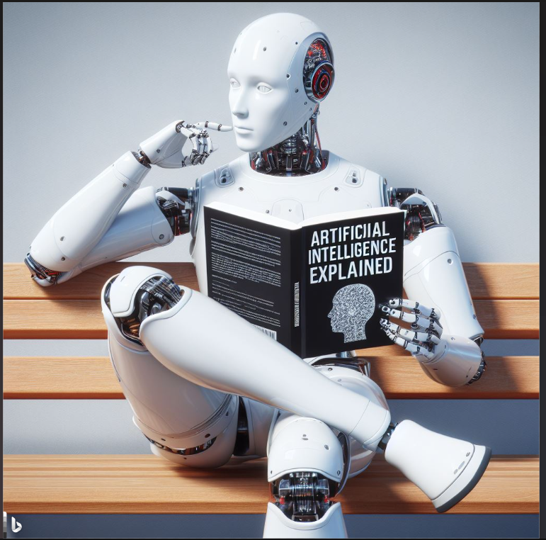
What is AI ?
Artificial Intelligence (AI)
Al is the theory and development Of computer systems able to perform tasks normally requiring human intelligence.
To build machines that think and act like humans.
Image generated by Edge using prompts
“generate an image with anime style with below information "AI" "question" "What is AI"“

Slide 5
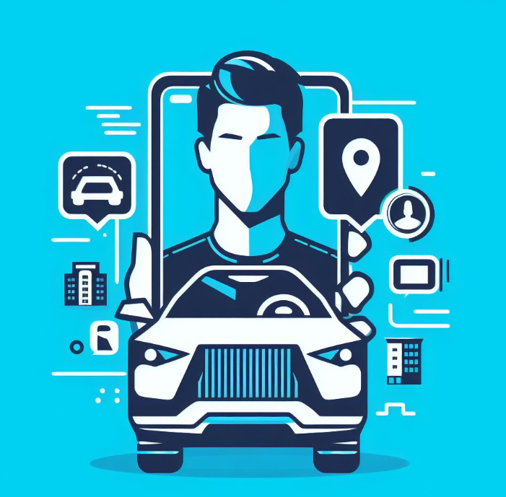
What is AI ?
Examples of Artificial Intelligence
Chatbots
Facial recognition
Self-driving cars
Smart assistants
Navigation apps
Image generated by Edge using prompts
“iconic style chatBot self driving car smart assistant navigation maps apps “

Slide 6
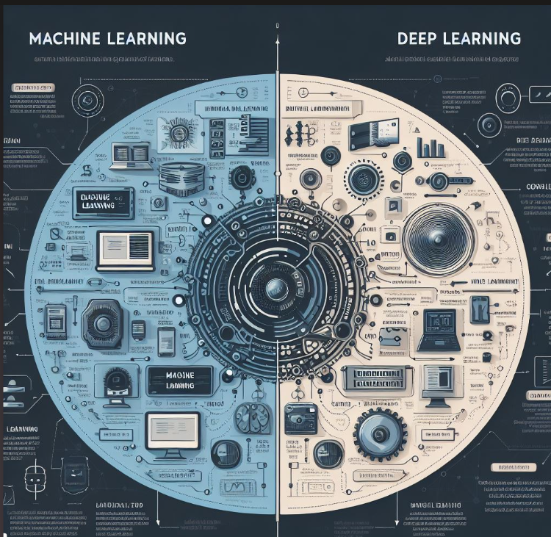
ML v.s Deep Learning
Machine Learning
Machine learning is a subfield of artificial intelligence
Focuses on the development of computer systems
that can learn and adapt without being explicitly programming
Examples
SVM / Decision Tree / HMM / Kmeans…
Image generated by Edge using prompts
“Machine learning versus Deep Learning“

Slide 7
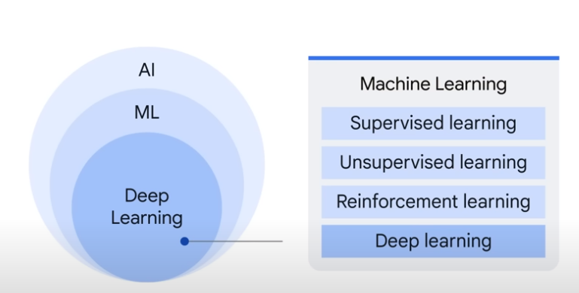
ML v.s Deep Learning
ML main subjects
Unsupervised Models
Supervised Models
Reinforcement Learning
Deep learning
https://www.youtube.com/watch?v=G2fqAlgmoPo

Slide 8
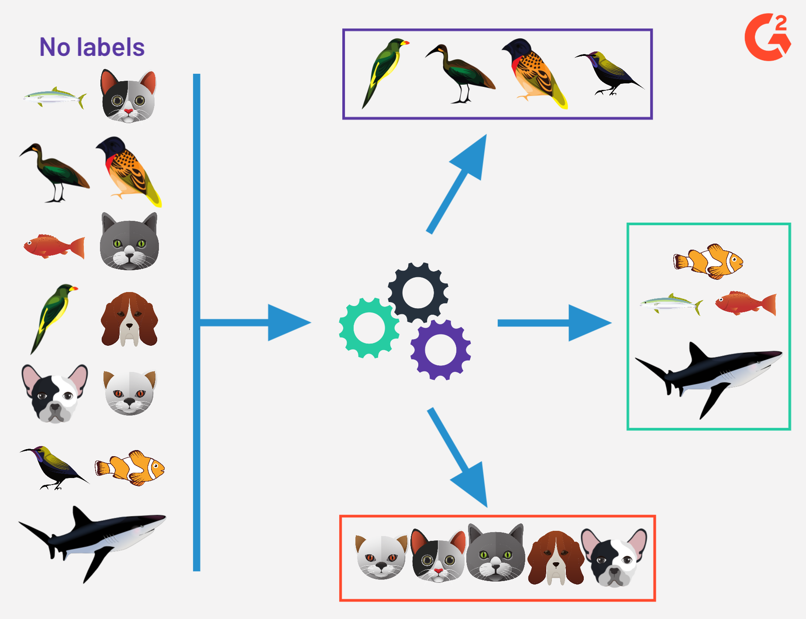
ML v.s Deep Learning
Unsupervised Models
No Labeled data needed
Pattern discovery
knowledge exploration

Slide 9
ML v.s Deep Learning
Unsupervised Models
Map Analyzer – PHC

Slide 10
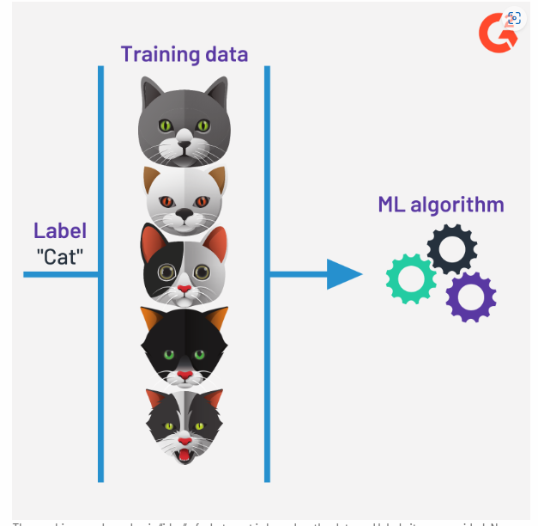
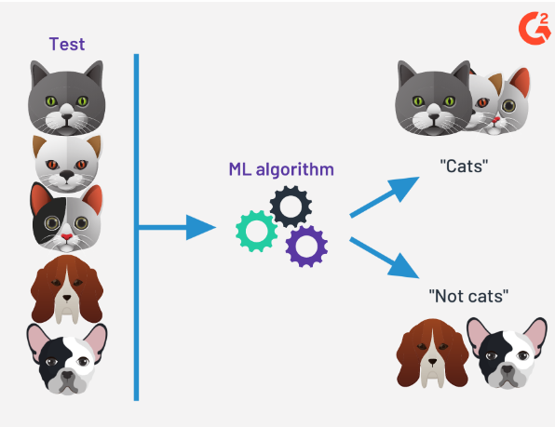
ML v.s Deep Learning
Supervised Models
Need labeled data to train the model
Model needed to be pre-built
Prediction / Classification / Pattern Matching
Step1: Train Model
Step2: Apply Model

Slide 11
ML v.s Deep Learning
Supervised Models
Map Analyzer - Klarity classifier
Map Analyzer - Probe Pattern Classification

Slide 12
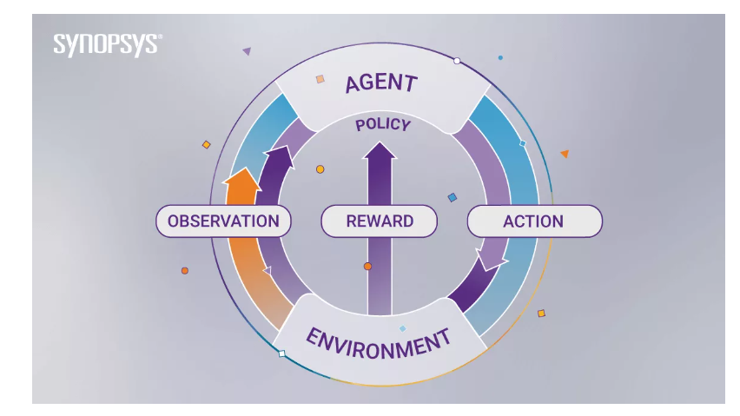
ML v.s Deep Learning
Reinforcement Learning
Achieve self learning by creating policies of
Reward
Punishment
Examples
video
Robotics
AlphaGo
Autonomous Driving
https://www.synopsys.com/ai/what-is-reinforcement-learning.html

Slide 13
ML v.s Deep Learning
Machine learning | Deep learning
A subset of AI | A subset of machine learning
Can train on smaller data sets | Requires large amounts of data
Shorter training and lower accuracy | Longer training and higher accuracy
Makes simple, linear correlations | Makes non-linear, complex correlations
Can train on a CPU (central processing unit) | Needs a specialized GPU (graphics processing unit) to train
https://www.coursera.org/articles/ai-vs-deep-learning-vs-machine-learning-beginners-guide

Slide 14
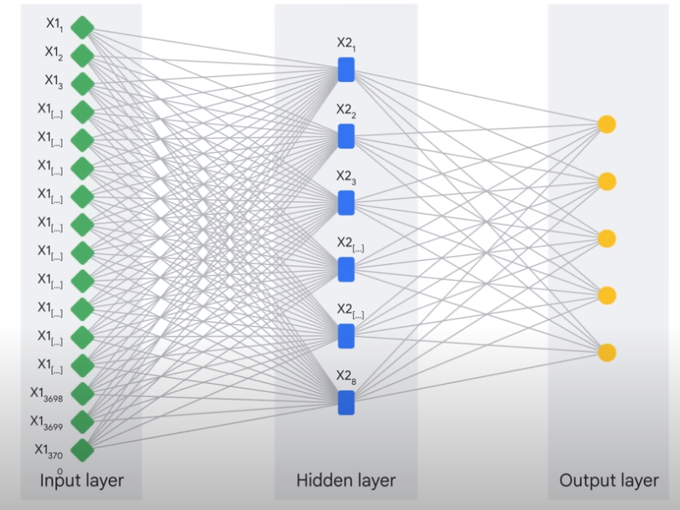
ML v.s Deep Learning
Deep Learning
Subset of machine learning that involves the use of
neural networks
It is essentially a neural network with three or
more layers that attempts to simulate the behavior
of the human brain
https://www.youtube.com/watch?v=G2fqAlgmoPo

Slide 15
ML v.s Deep Learning
Different types of Deep learning
CNN: Image recognition / Face ID
RNN: NLP, translation, stocks forecasting

Slide 16
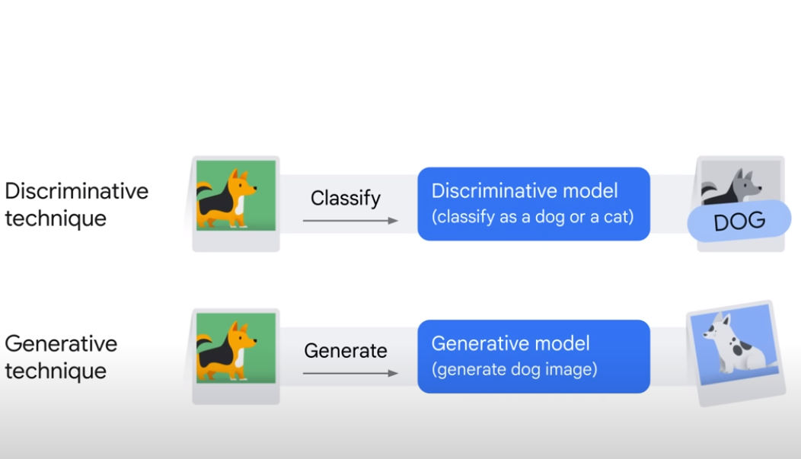
Gen AI
Deep Learning - Two different types
Discriminative model
Generative model
https://www.youtube.com/watch?v=G2fqAlgmoPo

Slide 17
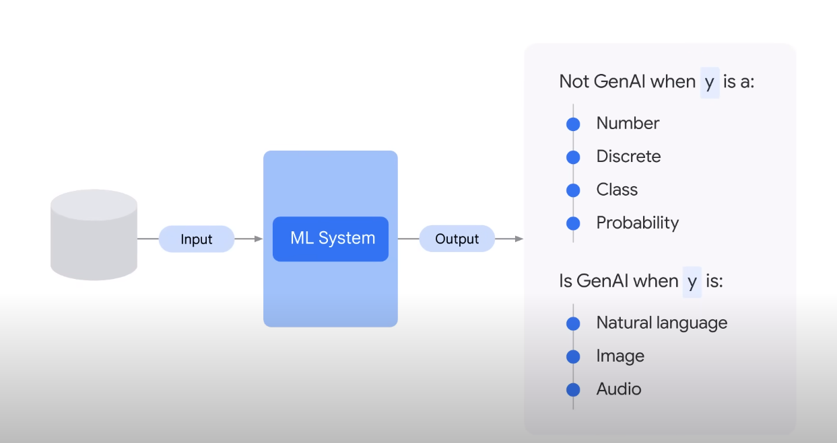
Gen AI
Use Deep learning to identify patterns in existing data
to generate new content
A type of AI that generates images, text, videos and other media
https://www.youtube.com/watch?v=G2fqAlgmoPo

Slide 18
Types of Gen AI

Slide 19
Types of Gen AI
Text
Image
Video

Slide 20
Gen AI – Text model
Q&A
Text Summarizing
Translation
Creating synthetic data
Being creative!!

Slide 21
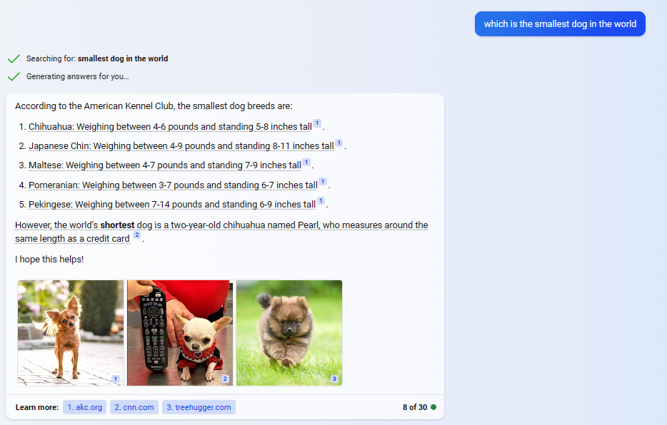
Gen AI – Text model
Q&A
Asking Edge “which is the smallest dog in the world

Slide 22
Gen AI – Text model
Q&A

Slide 23
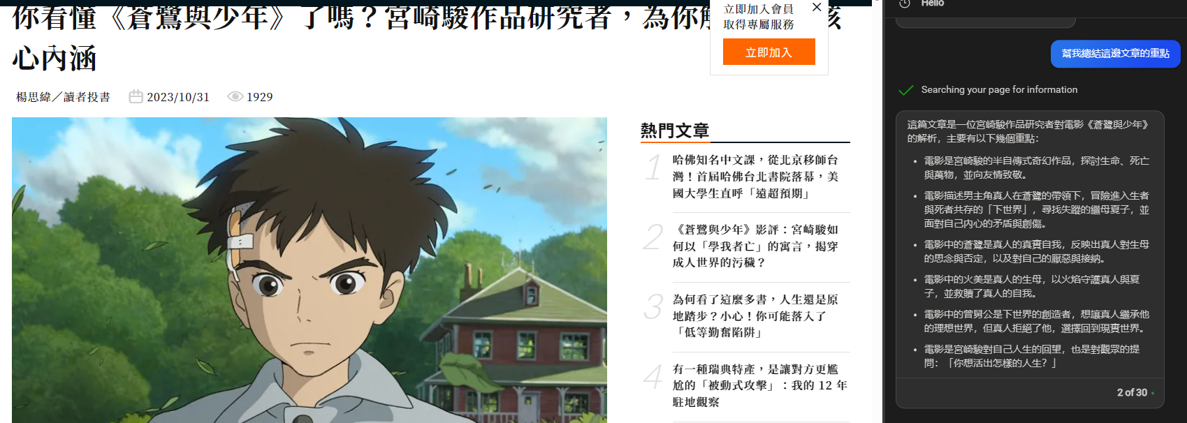
Gen AI – Text model
Text Summarizing

Slide 24
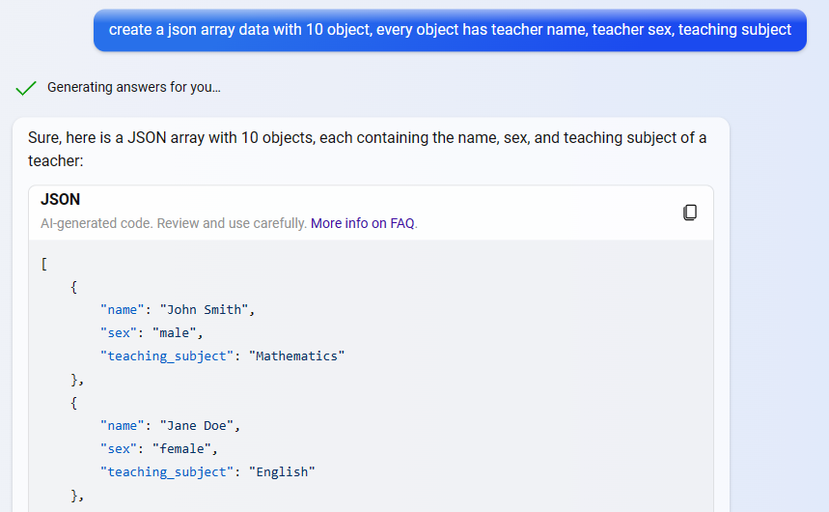
Gen AI – Text model
Creating synthetic data

Slide 25
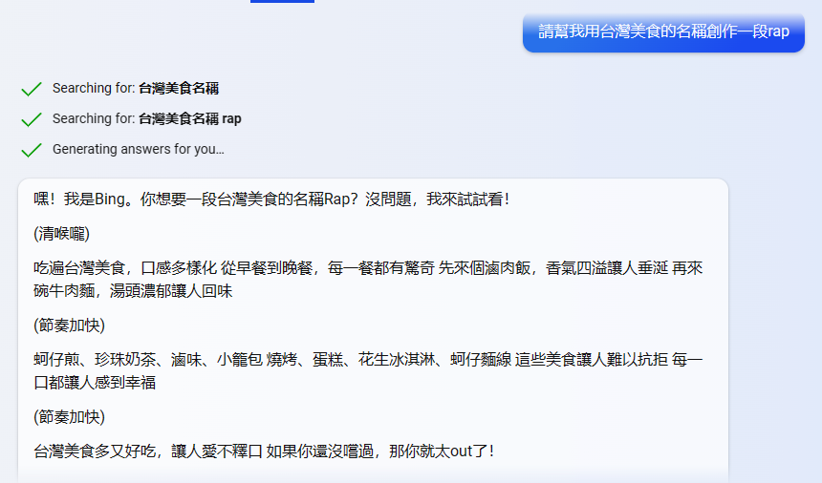
Gen AI – Text model
Being creative!!

Slide 26




Gen AI – Text model
Chatbot | Price | Developer | Technology | Plugin | Real time search | Information Access | Strength
ChatGPT | Free / Paid | OpenAI | GPT | Yes | Yes | Data up to 2021/9 (2022/1??) | Versatile Plugins Powerful capabilities of GPT-4 model
Claude 2 | Free (Paid for API) | Anthropic | Constitutional AI | No | Yes | Data up to early 2023 | Can handle up to 100K token / 75,000 words /~ a whole book Harmless AI assistant
Bard | Free | Alphabet/Google | PaLM2 | Yes | Yes | Keep updating model with information on the internet | support over 20 programming languages
Bing Chat | Free | Microsoft | N/A | Yes | Yes | Same as Chat GPT | In-text footnotes/links & Learn more links

Slide 27
Gen AI – Text model
LLM
Large lange model
Pretrianed
General purpose

Slide 28
Gen AI – Text model
Concern
dillusions

Slide 29

Gen AI – Image model
Image generated with below prompt using Dall-E 3
Generate anime image with following information:
night market, gun, air pollution, gangster , Tetrapod

Slide 30
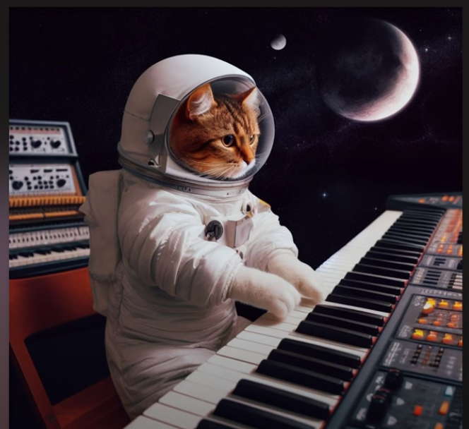
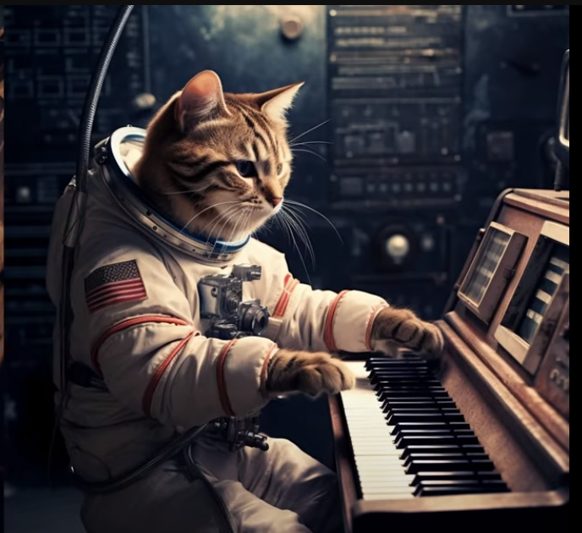
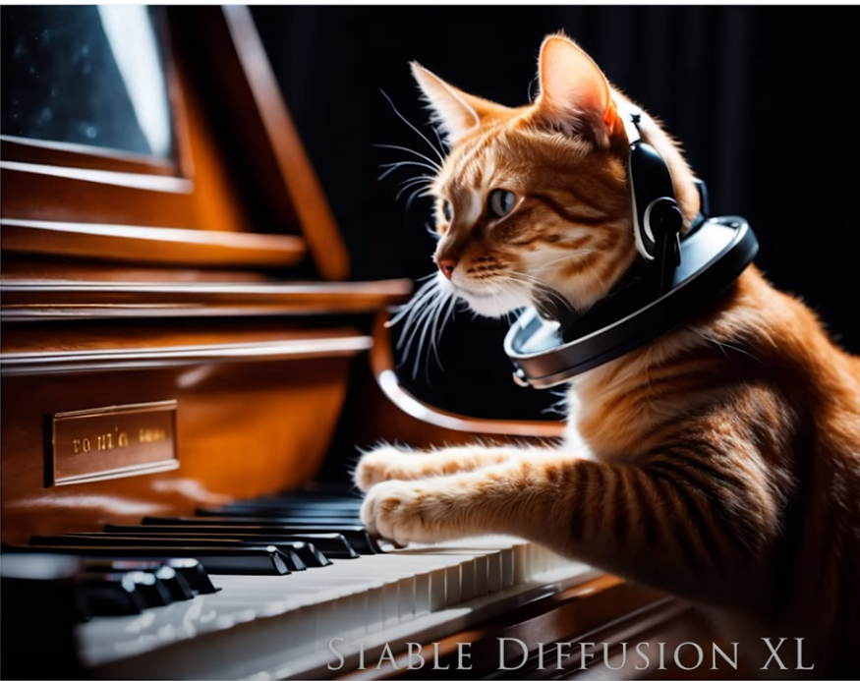
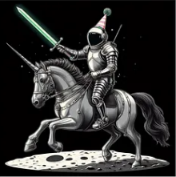
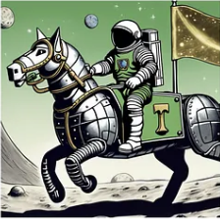
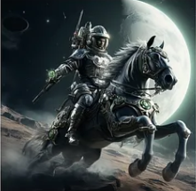

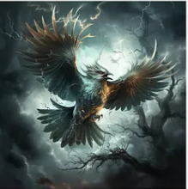
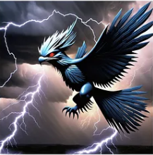
Gen AI – Image model
Dall-E 3 (OpenAI) | MidJourney | Stable Diffusion

Slide 31



Gen AI – Image model
Dall-E 3 (OpenAI) | MidJourney | Stable Diffusion
Can get the concept of the prompt | Can generate image with subtle details | Sometimes image are simplified
Generate less high quality image | Generate high quality image | Generate satisfactory quality image

Slide 32

Gen AI – Video model

Slide 33
Gen AI Tools in Micron

Slide 34
Gen AI - Available now
Bing chat enterprise

Slide 35
Gen AI – in Future Roadmap
Zoom
tabnine

Slide 36
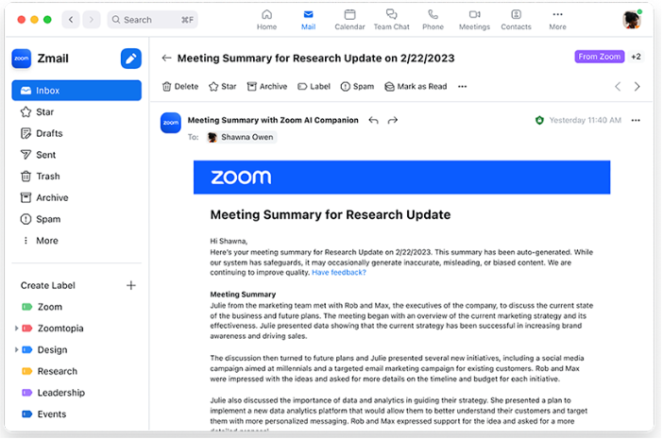
Zoom
Schedule
Zoom Campanion AI targetd to world release on 10/31
Now has been pushed to “on Hold” for the release since 10/31
Features
Meeting summary
Smart Recording
Asking in-meeting questions

Slide 37
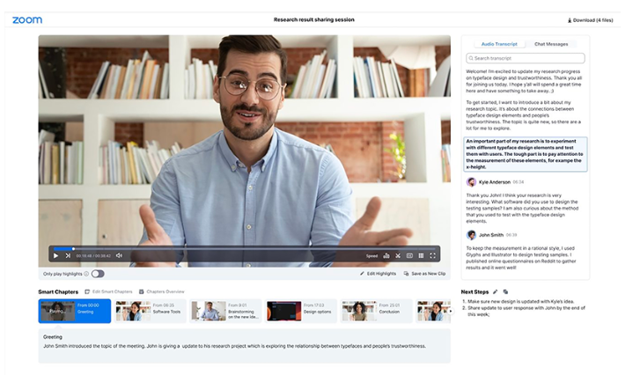
Zoom
Schedule
Zoom Campanion AI targetd to world release on 10/31
Now has been pushed to “on Hold” for the release since 10/31
Features
Meeting summary
Smart Recording
Asking in-meeting questions

Slide 38
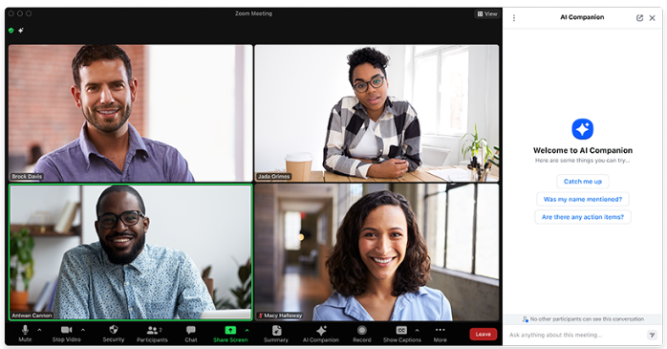
Zoom
Schedule
Zoom Campanion AI targetd to world release on 10/31
Now has been pushed to “on Hold” for the release since 10/31
Features
Meeting summary
Smart Recording
Asking in-meeting questions

Slide 39
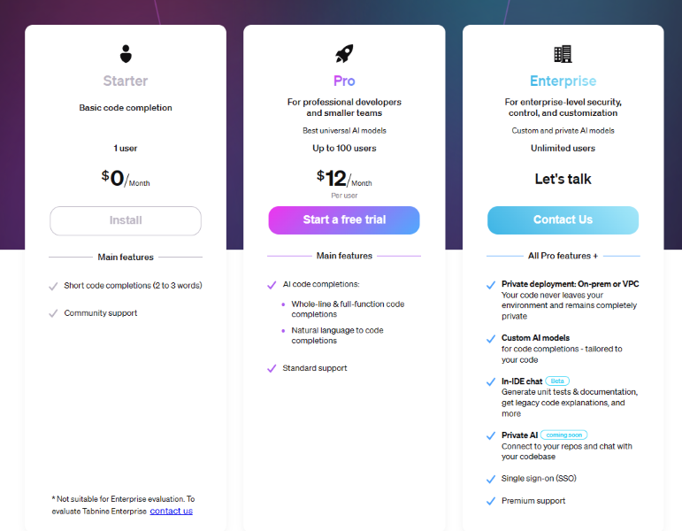
Tabnine
Tabnine is a code completion
Code generation tools (Pro version)
Coding assistant with strong privacy (Enterprise Version)

Slide 40
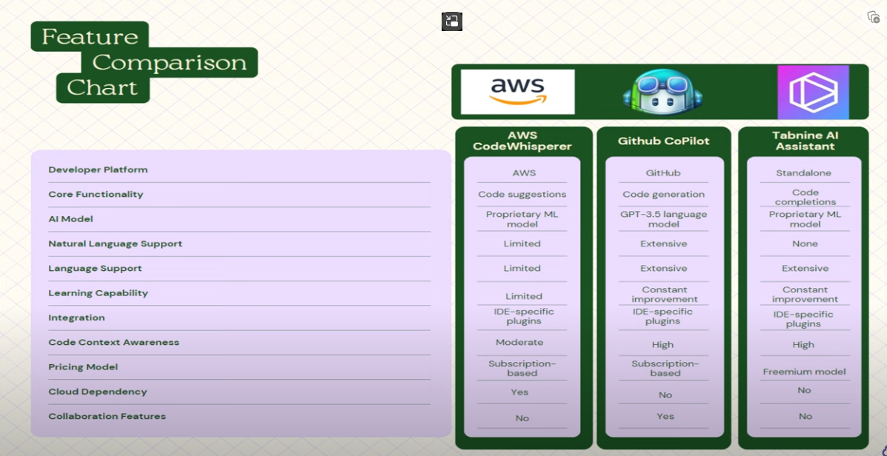
Tabnine
Comparisons between 3 population AI code assistant

Slide 41
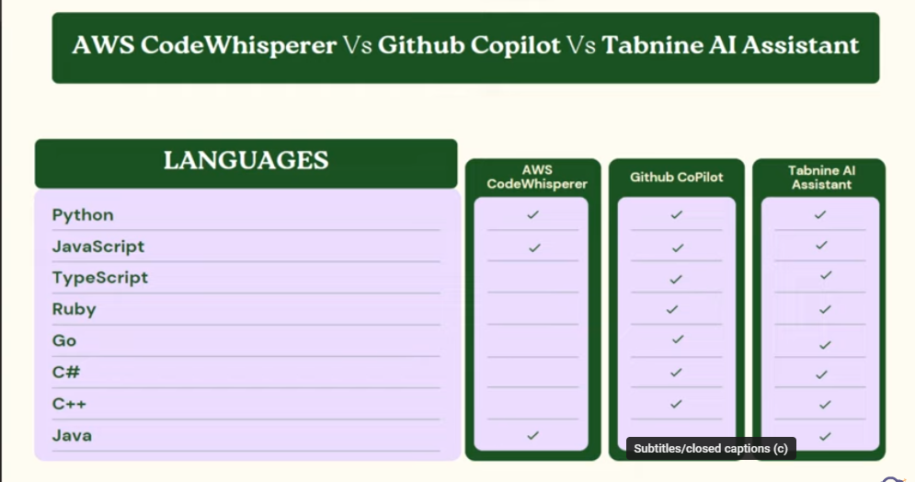
Tabnine
Comparisons between 3 population AI code assistant

Slide 42
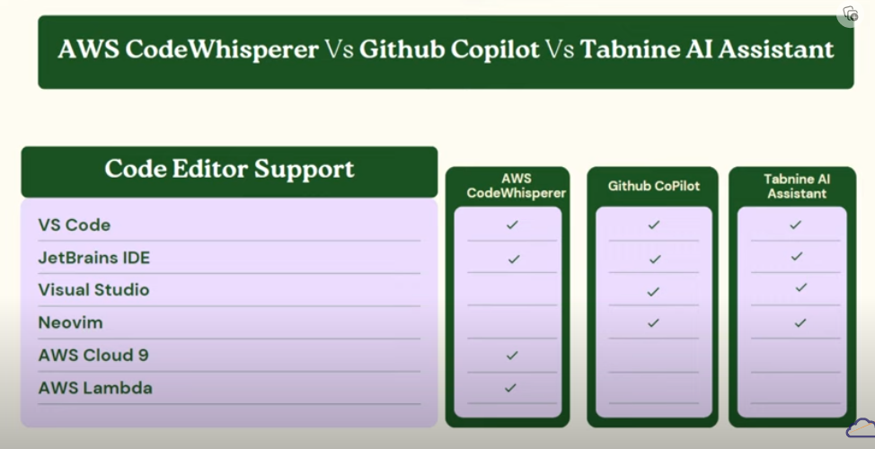
Tabnine
Comparisons between 3 population AI code assistant

Slide 43
Tabnine
Parameter | Tabnine Enterprise | Copilot | Copilot Business
Code privacy Public AI model training on your code | No, Tabnine Enterprise doesn’t use your code to train general AI models. | Yes, Copilot does use your code to train general AI models. However, it’s possible to opt out individually for each user in the org. | No, Copilot Business doesn’t use your code to train public AI models.
Code privacy: Code isolation & protection | Self hosting - ability to install on your VPC or on-premise Your code is never sent to Tabnine, other than information needed to manage your licenses and get updates Full control over the IP and protection against IP leakage | Transmits snippets of your code from your IDE to GitHub in order to provide code suggestions No control over code security or protection against IP leakage on the Microsoft side | Same as Copilot
Open source compliance | Totally secure - Tabnine doesn’t train its AI models on code with non-permissive licenses Full transparency regarding the code that the models are trained on Provides a full list of open-source libraries used to train our models, allowing users to access the attribution list and avoid potential legal issues | Trained on non-permissive open source licenses, including GPL licenses with Copyleft clauses, leaving companies open to potential legal risk Possibility to use a filter that removes problematic code from suggestions, however this solution doesn’t always work, so the legal risk still exists | Same as Copilot
Tabnine is more fridendly to Enterprise / Starup
From security perspective

Slide 44
Tabnine
Parameter | Tabnine Enterprise | Copilot | Copilot Business
Ability to connect AI models to an org’s code repository | Supported Tabnine Enterprise also allows the organization to choose which code the models should be trained on Connect AI models to different repos for different teams The training and the model are only served in the isolated environment not shared with any other customer of tabnine | Not supported; AI models are trained only on OpenAI | Same as Copilot
User management | Supported, allowing you to manage access roles and permissions Supports SAML integration with the company’s internal user management | Not supported | Supported, allowing you to manage access roles and permissions
Tabnine is more fridendly to Enterprise / Starup
From security perspective

Slide 45
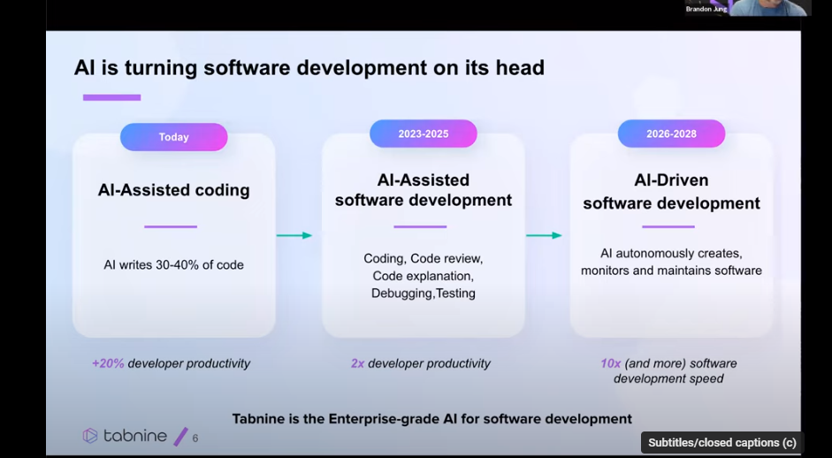
Tabnine
Tabnine is more fridendly to Enterprise / Starup
From security perspective

Slide 46
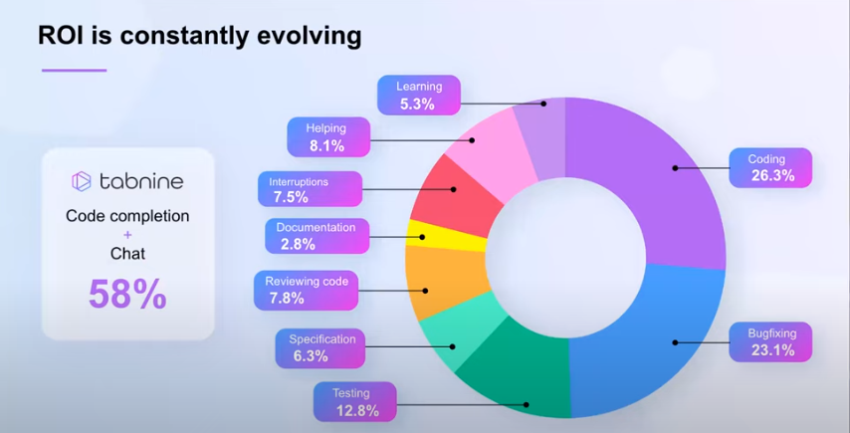
Tabnine
AI code might help you

Slide 47
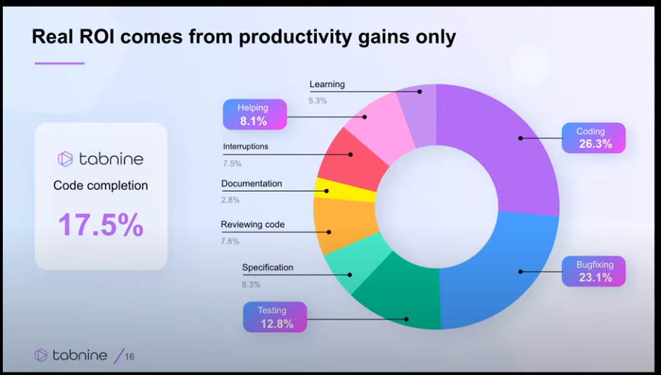
Tabnine
AI code might help you

Slide 48
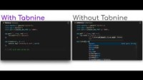
Tabnine usage examples
Code completion
Code generation
Tabnine chat
Code review
Refacotring
Write documentation
Explain
Code fixing

Slide 49
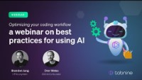
Tabnine usage examples
Code completion
Code generation
Tabnine chat
Code review
Refacotring
Write documentation
Explain
Code fixing

Slide 50
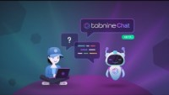
Tabnine usage examples
Code completion
Code generation
Tabnine chat
Code review
Refacotring
Write documentation
Explain
Code fixing

Slide 51
What is the impact of Gen AI
To Developer
85% of developers felt more confident in their code quality when authoring code with GitHub Copilot and GitHub Copilot Chat.
Code reviews were more actionable and completed 15% faster with GitHub Copilot Chat.
88% of developers reported maintaining flow state with GitHub Copilot Chat because they felt more focused, less frustrated, and enjoyed coding more, too.
https://github.blog/2022-09-07-research-quantifying-github-copilots-impact-on-developer-productivity-and-happiness/
https://github.blog/2023-10-10-research-quantifying-github-copilots-impact-on-code-quality/

Slide 52
What is the impact of Gen AI
To everyone

Slide 53
References
Deep Learning
Deep Learning | What is Deep Learning? | Deep Learning Tutorial For Beginners | 2023 | Simplilearn – YouTube
CNN / RNN
CNN 與 RNN 之間的差異？ - NVIDIA 台灣官方部落格

Slide 54
Thank for the listening

